Slide 1
Regulating Blood Sugar

Slide 2
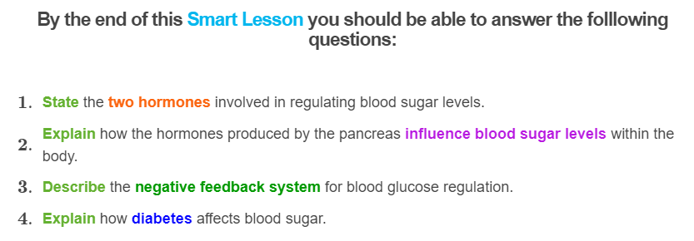
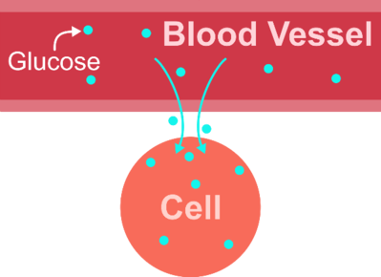

Slide 3
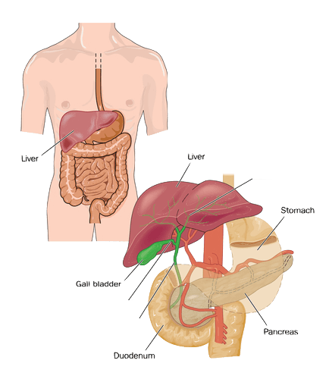
The Pancreas
The gland that makes the two hormones involved in regulating blood sugar levels is the pancreas!
The pancreas is a long, flat gland in your belly that sits behind the stomach.

Slide 4
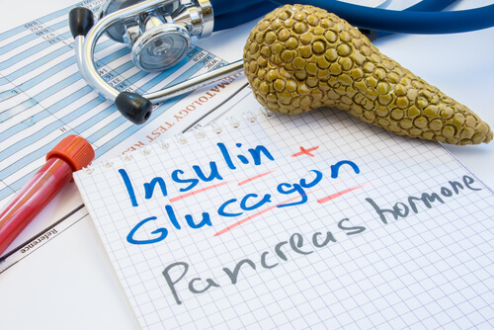
The pancreas produces and secretes insulin and glucagon, among other hormones!
Both insulin and glucagon are important to maintaining a constant level of glucose (a type of sugar) in the blood.
Both hormones are required to keep the levels of blood glucose in the narrow range that is required by your body.

Slide 5
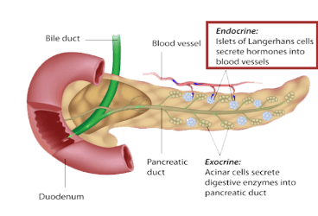
Insulin and Glucagon
Insulin and glucagon are produced by the 'endocrine' cells in the pancreas, called islet cells.
Insulin is secreted by beta cells (a type of islet cell). These cells also detect whether there is an increase in blood glucose.
Glucagon is secreted by alpha cells (another type of islet cell). These cells detect whether there is a decrease in blood glucose.

Slide 6

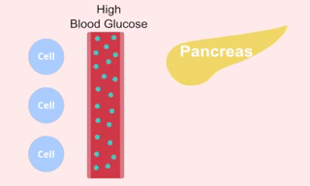
Insulin is released from the pancreas to lower blood sugar level after a meal
When you eat a meal, your blood sugar will increase.
As a result, your pancreas releases insulin to help lower the blood sugar back to normal levels.
Insulin acts by binding to cells which allows the cells to then take up the glucose from the bloodstream, resulting in normal blood sugar levels.

Slide 7
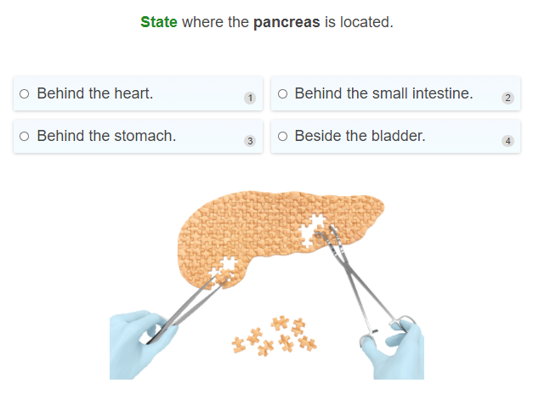

Slide 8
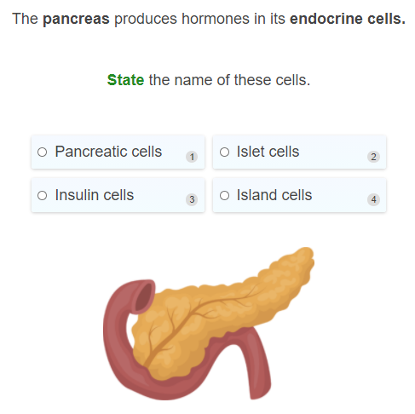

Slide 9
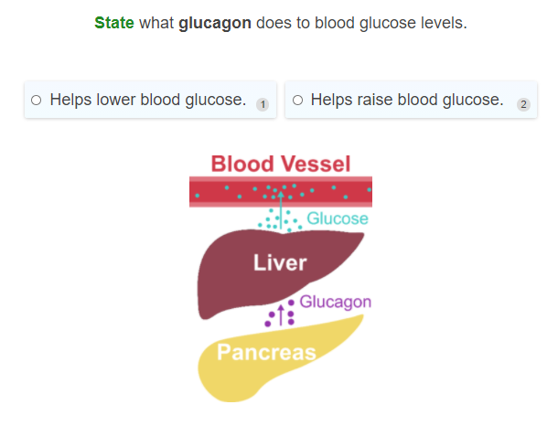

Slide 10
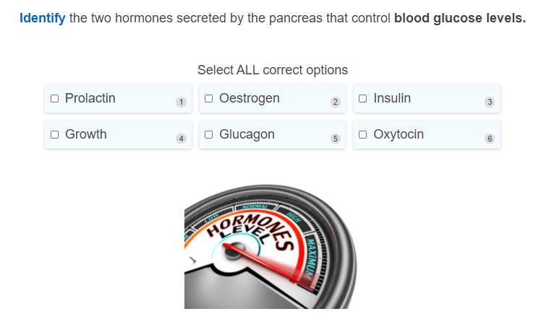

Slide 11
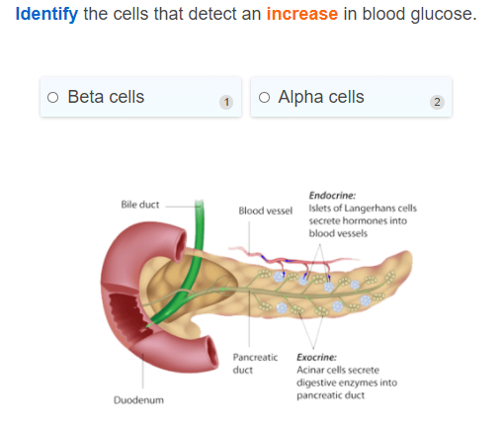

Slide 12
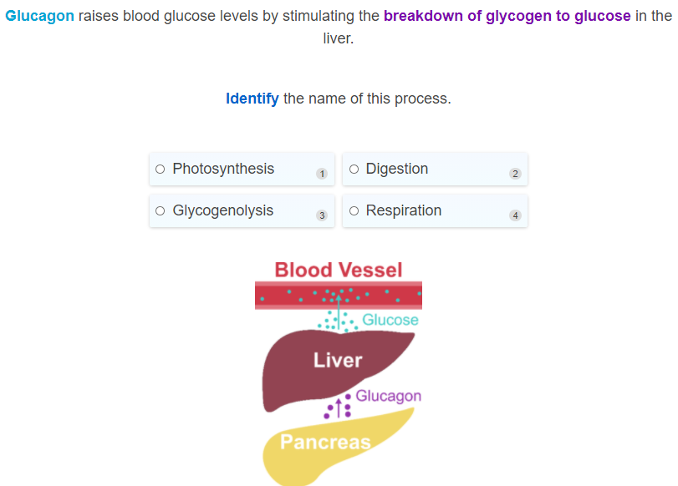

Slide 13
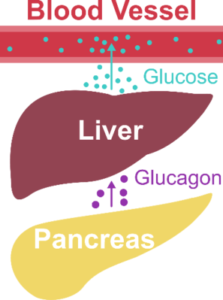

Between meals and during exercise, the blood glucose levels can become low.
The low blood glucose levels are detected by the alpha cells in the pancreas, which then secrete the hormone glucagon to raise the blood glucose levels back to normal.

Slide 14

Glucagon
Glucagon raises blood glucose levels by causing the breakdown of glycogen to glucose in liver cells. This process is called glycogenolysis.
Homeostasis is restored as blood glucose levels returns to the set point.

Slide 15
Let's summarise what we have learnt so far about the roles of insulin and glucagon!
When blood glucose is low between meals and during exercise this is detected by alpha cells. Glucagon is secreted which increases blood glucose levels.
After a meal, the increase in blood glucose is detected by beta cells. Insulin is secreted into the blood which decreases blood glucose levels.

Slide 16
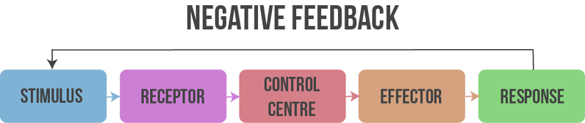
Normal blood glucose levels are maintained through a negative feedback loop.
This is an example of the endocrine system being involved in homeostasis!
You should recall the term negative feedback from the homeostasis module. If not, the diagram below should refresh your memory.
Negative feedback loops are triggered by a change in the internal environment and results in a response that aims to restore equilibrium.

Slide 17
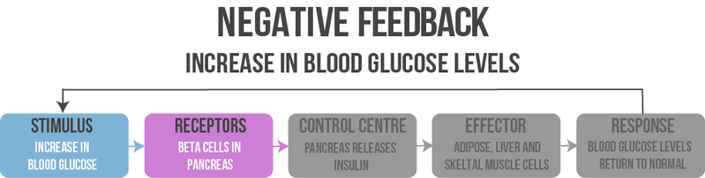
Regulating an increase in blood glucose levels I
After eating a meal, blood glucose levels increase. This is the stimulus.
The receptors which detect this increase in blood glucose are the beta cells in the pancreas.

Slide 18
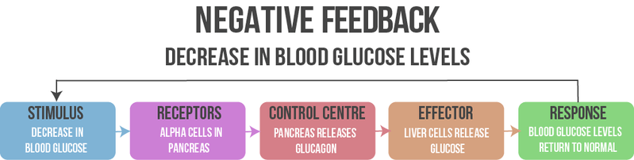
A decrease in blood glucose levels is also regulated by a negative feedback loop.
When blood glucose levels decrease in between meals or during exercise, this stimulus is sensed by the alpha cells of the pancreas.
As a response to this stimulus, alpha cells in the pancreas secrete glucagon.
Glucagon stimulates the breakdown of glycogen in the liver into glucose which is then secreted out into the bloodstream.
As a result, blood glucose levels return back to normal and the pancreas stops producing glucagon.

Slide 19
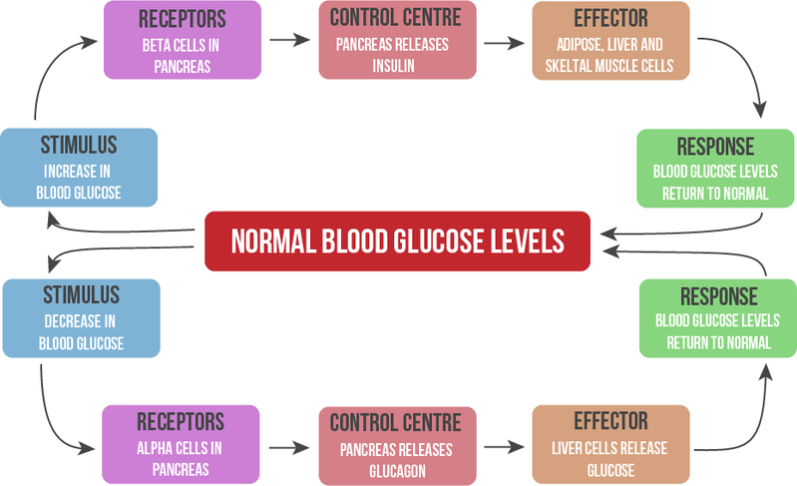
The below picture is a summary of the blood glucose negative feedback system.

Slide 20
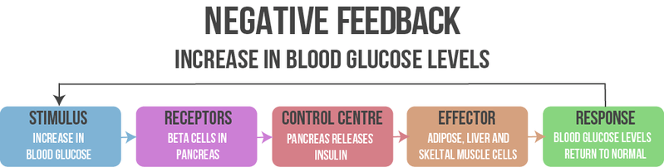
Regulating an increase in blood glucose II
In response to this, the pancreas releases insulin.
Insulin signals for cells such as adipose (fat), liver and skeletal muscle cells to take in glucose from the blood stream.
As a result, blood glucose levels then fall back to normal range. The normal blood glucose levels are detected by the pancreas which then stops producing insulin.

Slide 21
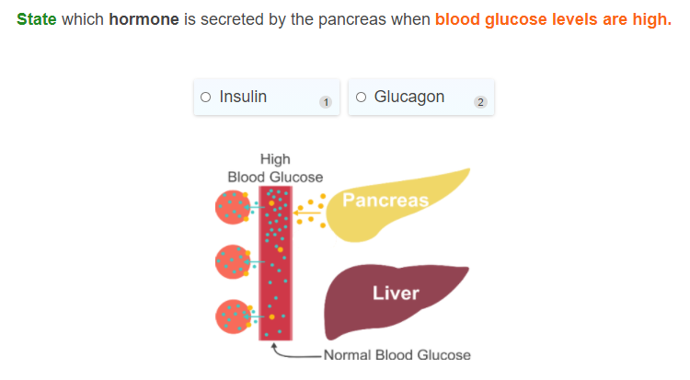

Slide 22
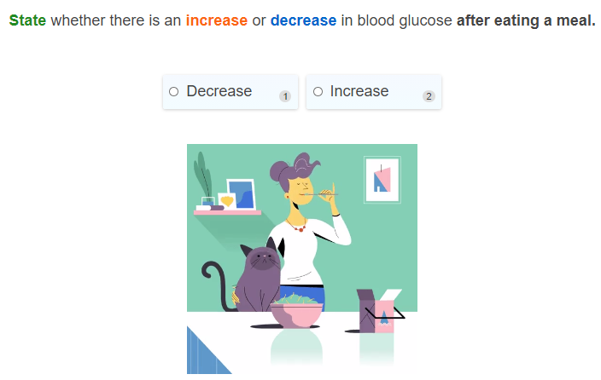

Slide 23
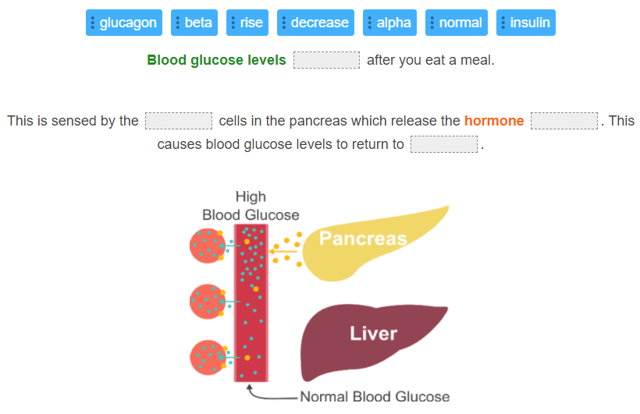

Slide 24
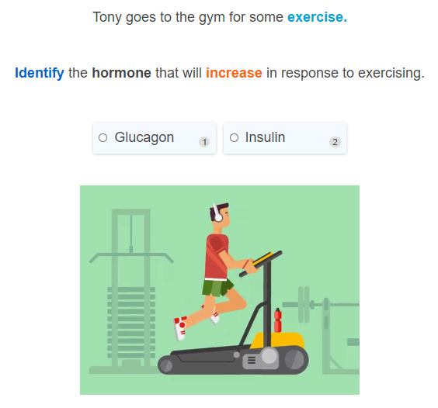

Slide 25
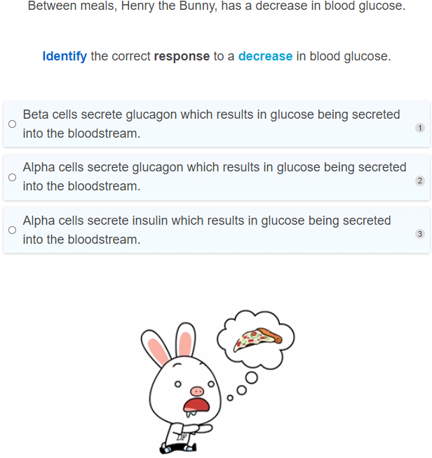

Slide 26
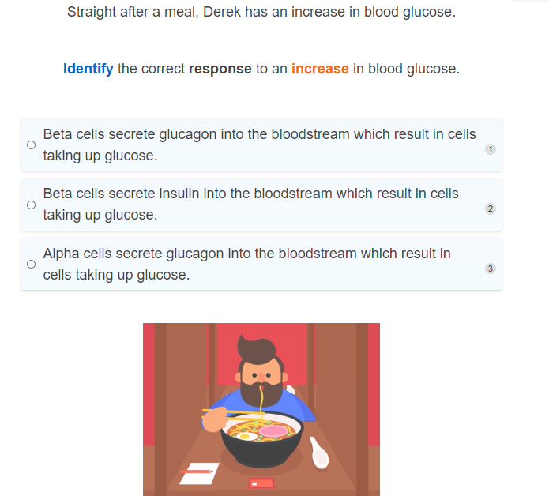

Slide 27
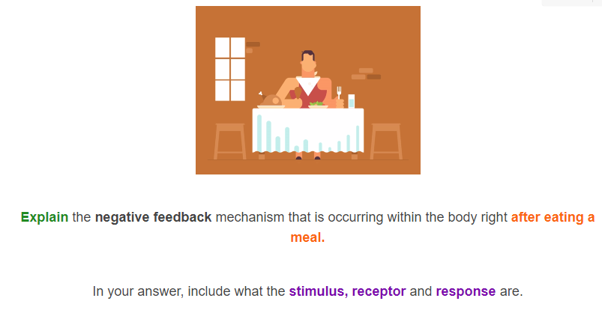

Slide 28
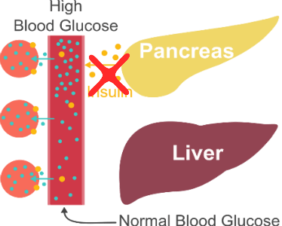
Diabetes
Diabetes is a disease where the pancreas can no longer make insulin or your body cannot use the insulin produced by the pancreas.
This means that patients with diabetes will have high blood sugar levels unless treated.

Slide 29
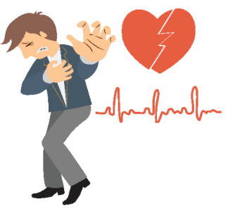
Diabetes: When the body can't make or use insulin like it should be.
If someone has diabetes, the body either can't make insulin or the insulin doesn't work in the body like it should.
The glucose can't get into the cells normally, so the blood sugar level gets too high.
Lots of sugar in the blood can make people sick if they don't get treatment. Long term problems can also result from high blood sugar levels such as heart disease, stroke and many more.

Slide 30
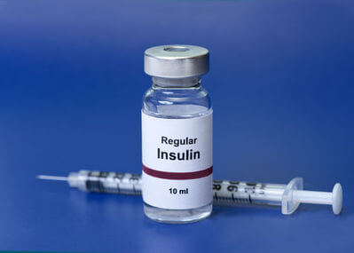
There are 2 main types of diabetes: type 1 and type 2.
Type 1 diabetes: This is where the pancreas can't make insulin.
In patients with type 1 diabetes the beta cells in the pancreas are usually destroyed by the body's immune system so that they cannot produce insulin. Patients who have type 1 diabetes are usually diagnosed at a young age.
Gestational diabetes is another type of diabetes that is similar to type 2 and can develop during pregnancy. There are also many other forms of diabetes that are very rare.

Slide 31
Type 2 diabetes
Type 2 diabetes: This is where the pancreas still makes insulin, but the body doesn't respond to the insulin. As a result, blood sugar levels get too high. Type 2 diabetes can develop at any age and is commonly seen in overweight people.

Slide 32
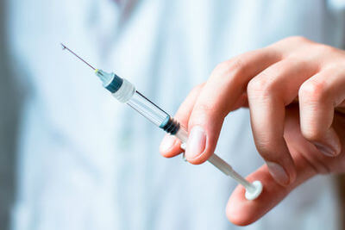

Treatment for diabetes
Treatment for type 1 diabetes is usually with insulin injections as well as a healthy diet and regular exercise.
Treatment for type 2 diabetes may be managed with non-insulin medications, insulin injections, weight reduction, regular exercise and/or dietary changes.

Slide 33
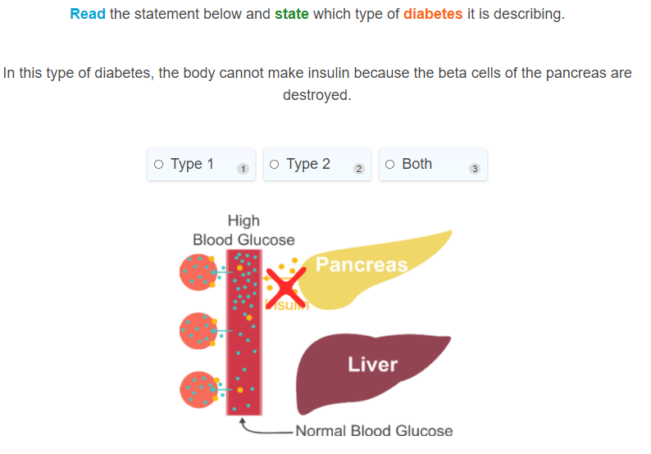

Slide 34
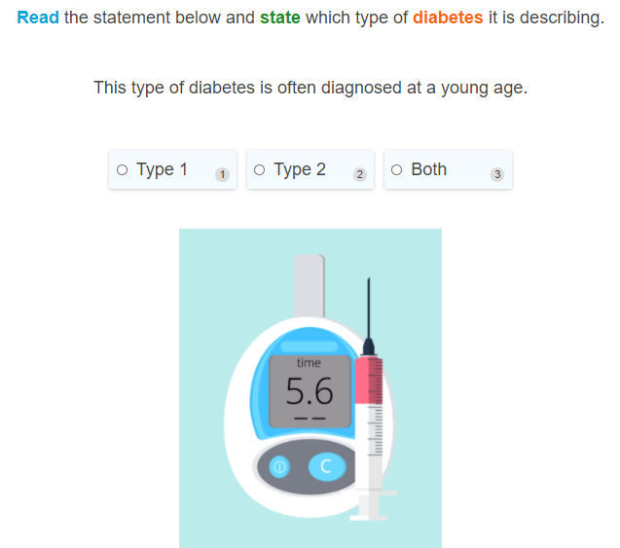

Slide 35
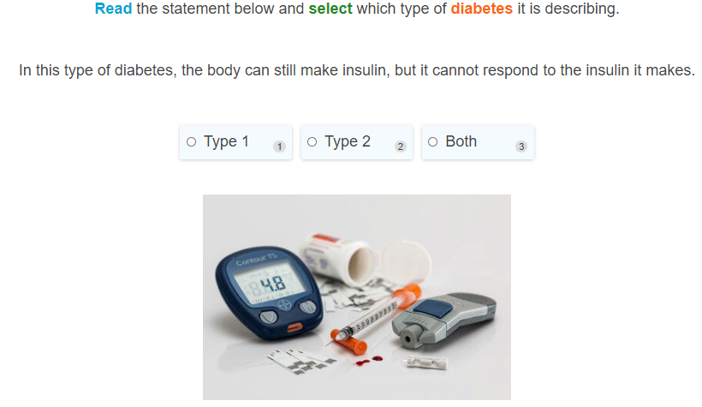

Slide 36
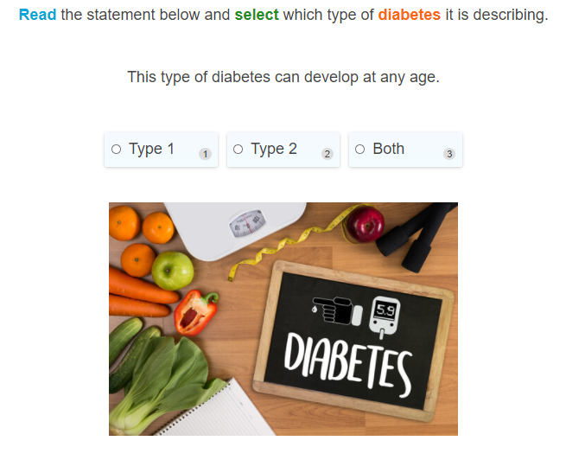

Slide 37
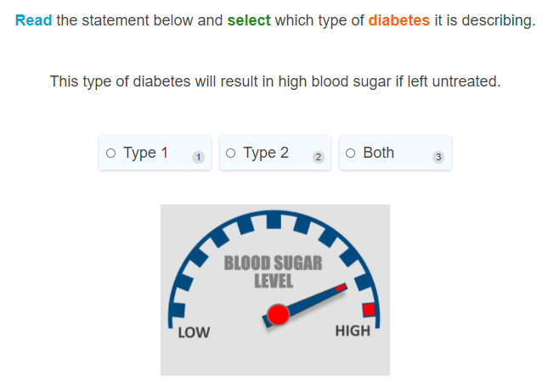

Slide 38
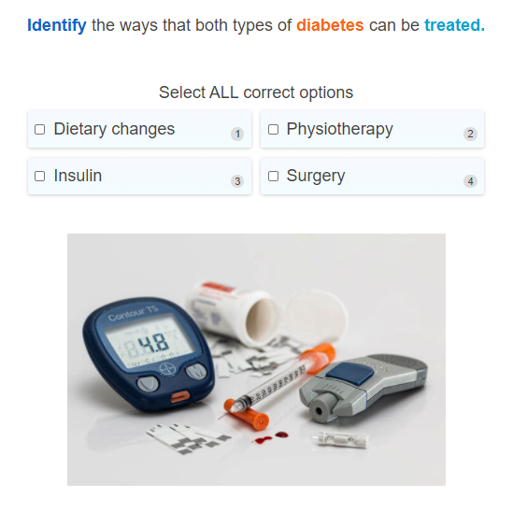

Slide 39
